Slide 1

Product Segment
By
Team SAS
Srivatsav Vuddamarry
Anderson Klein
Sankalp Thakur

Slide 2
Business Strategy
Apple’s strategy is to focus on it’s product line with product differentiation, which delivers a one stop solution ecosystem with highly integrated hardware and software and a strong focus on marketing, design and easy of use. Their ethos is Quality over Quantity.

Slide 3
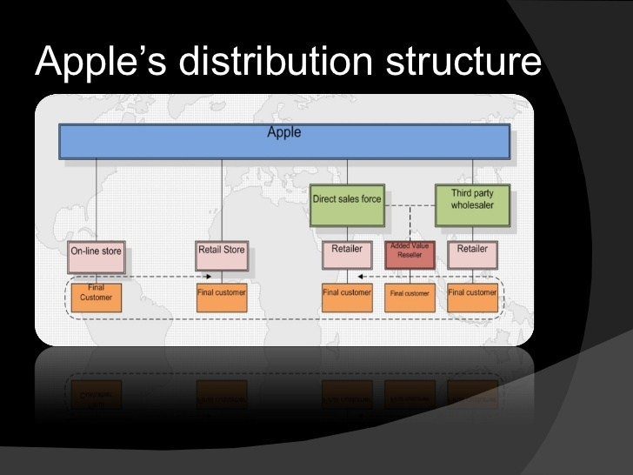
https://mpk732.wordpress.com/2015/05/16/apples-sales-and-channel-strategy-key-to-its-success/

Slide 4
Sales:
Apple’s retail and online storefronts are unique.
They’re more about education and support than selling.
They’re simple, even austere, with minimal signage and crystal clear messaging.
Apple is planning to open up stores in high traffic location in urban areas as architectural masterpieces, even though most of its sales happen via indirect distribution channels.
The main takeaway is that often companies engage in direct distribution strategies which are quite expensive and not necessarily tied to just revenue generation.
https://mpk732.wordpress.com/2015/05/16/apples-sales-and-channel-strategy-key-to-its-success/
Notes:
From its direct and channel pricing strategy to its retail and online storefronts, Apple sells its products like no other company in the consumer electronics space.

Slide 5
Stores as Marketing and cognitive gaps
The main takeaway is that often companies engage in direct distribution strategies which are quite expensive and not necessarily tied to just revenue generation. A store where Apple can sell its products directly to the consumers has a massive branding advantage.
Apple can open up those stores in high traffic location in urban areas, and those stores often are architectural masterpieces, which want to capture the collective imaginary of people around the world, even though most of its sales happen via indirect distribution channels.
https://mpk732.wordpress.com/2015/05/16/apples-sales-and-channel-strategy-key-to-its-success/

Slide 6
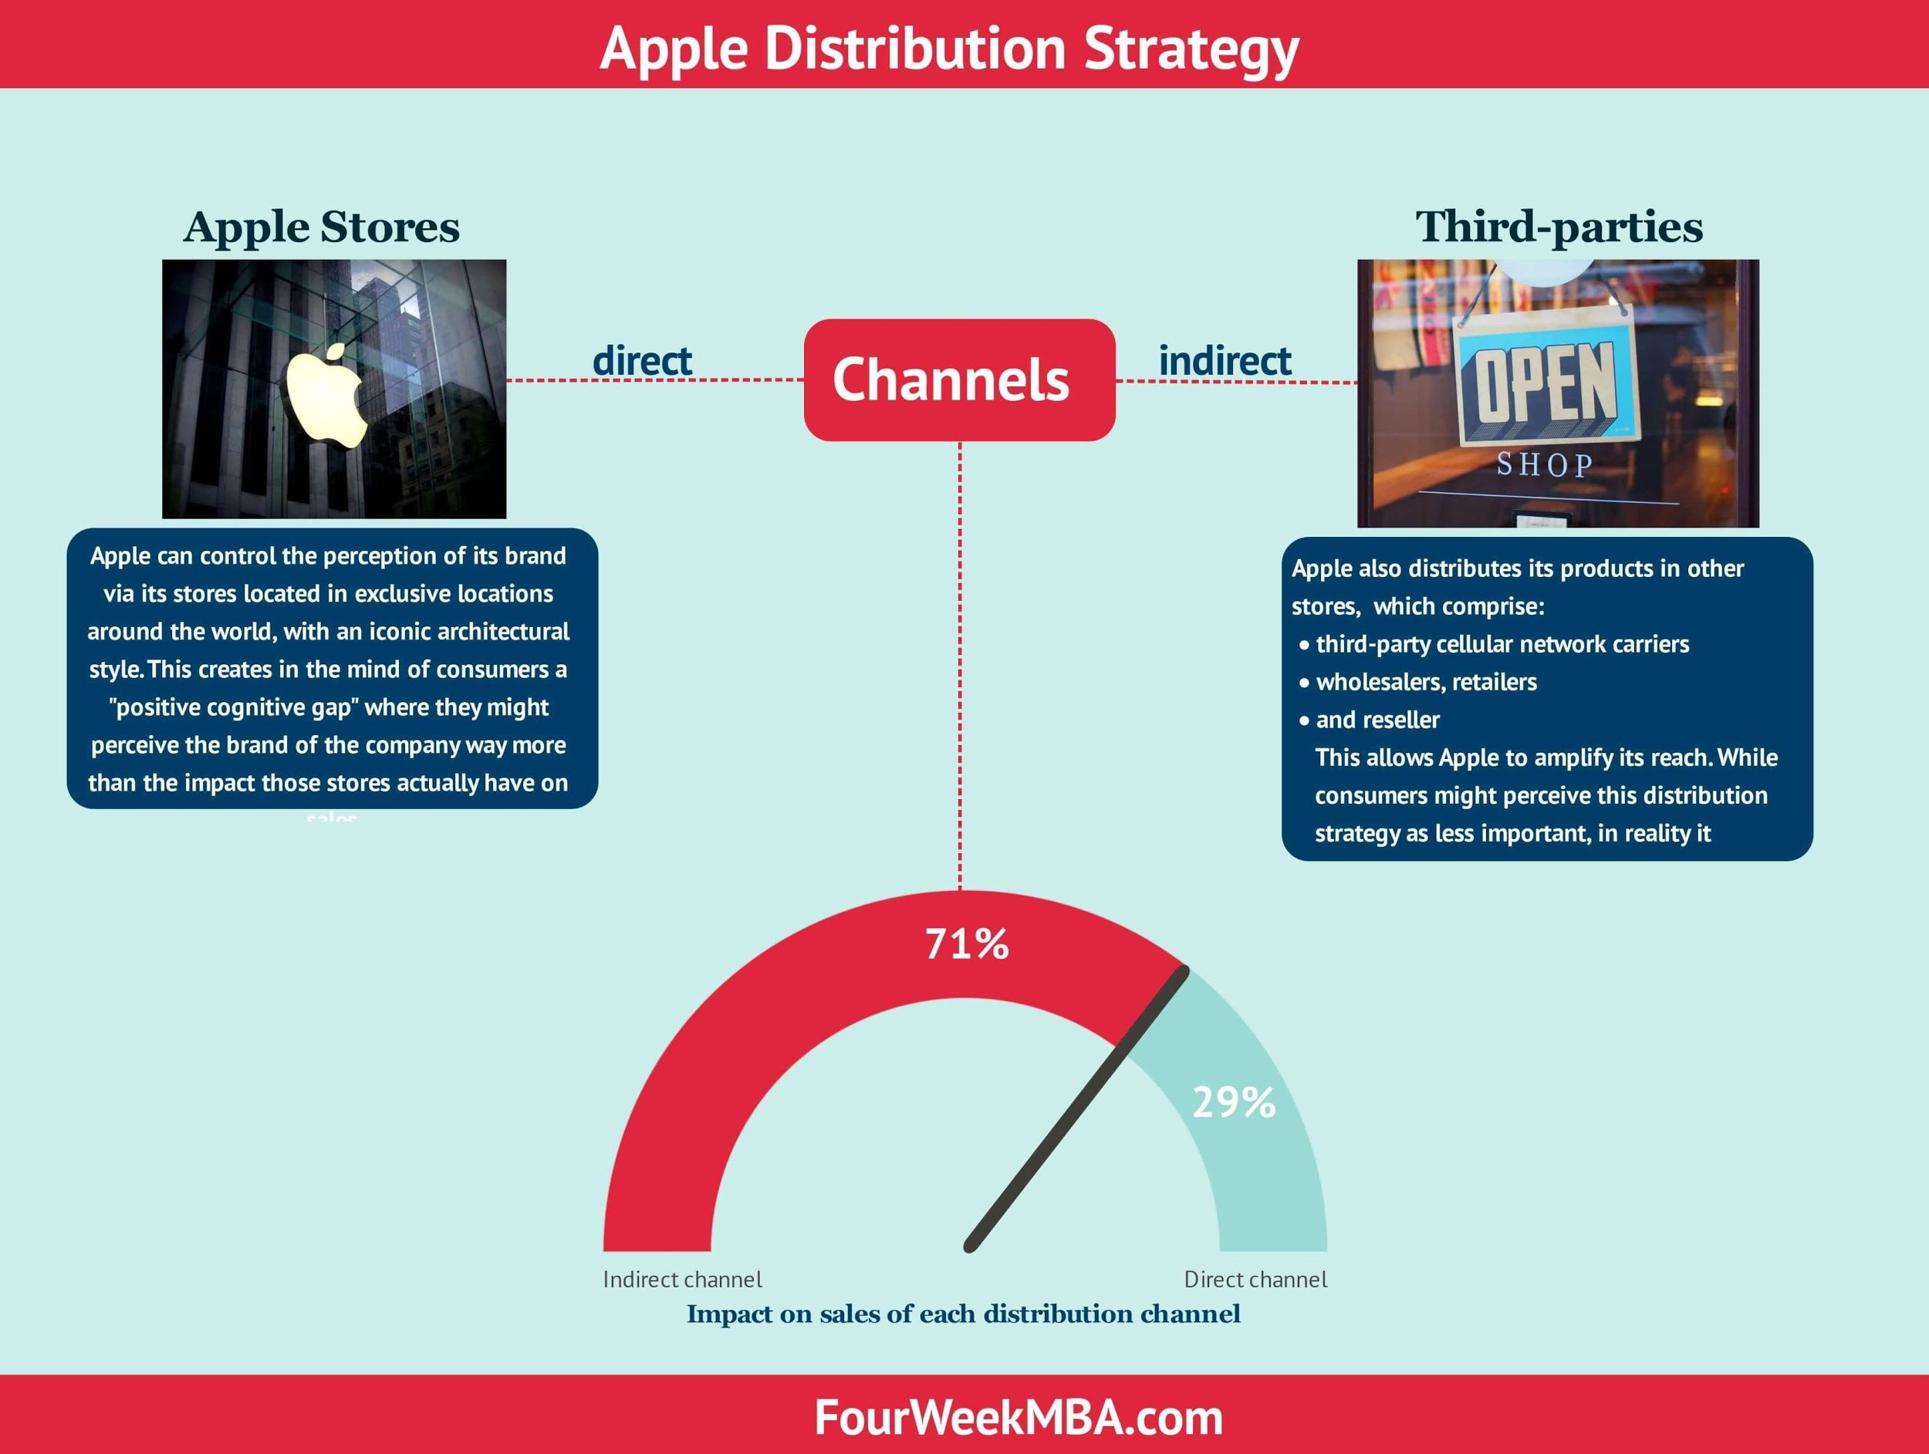
https://fourweekmba.com/apple-distribution-strategy/

Slide 7
Legal:
The Company’s business is subject to a variety of U.S. and international laws, rules, policies and other obligations regarding data protection.
As a company that invents and reinvents entire categories and industries, Apple challenges its legal team with unique and often unexplored aspects of the law. This group provides worldwide support for all our products and business, ensuring compliance with Apple’s high ethical and corporate standards as well as defending our intellectual property. Areas of work include Corporate Law, Paralegal Services, Legal Operations, Project Management, and Administration.

Slide 8
Functions - Product and Engineering/R&D
Design as much of the software and hardware in-house.
Develop or acquire exclusive technologies.
Catch up in software and predict disruptors.
https://www.cbinsights.com/research/report/apple-strategy/

Slide 9
Functions - Marketing
Online Marketing: Limited(Influencers/3rd Parties).
Channel Marketing: Tightly control prices with MAP.
Field Marketing: Limited to Enterprise Customers.
https://www.forbes.com/sites/christinemoorman/2018/01/12/why-apple-is-still-a-great-marketer-and-what-you-can-learn/#3e57e19b15bd https://www.businessinsider.com/apples-shifting-online-ad-strategy-2014-4

Slide 10
Functions - Finance
Apple annual/quarterly operating income history and growth rate from 2006 to 2019. Operating income can be defined as income after operating expenses have been deducted and before interest payments and taxes have been deducted.
Apple operating income for the quarter ending December 31, 2019 was $25.569B, a 9.52% increase year-over-year.
Apple operating income for the twelve months ending December 31, 2019 was $66.153B, a 2.67% decline year-over-year.
Apple annual operating income for 2019 was $63.93B, a 9.83% decline from 2018.
Apple annual operating income for 2018 was $70.898B, a 15.57% increase from 2017.
Apple annual operating income for 2017 was $61.344B, a 2.2% increase from 2016.
https://www.statista.com/statistics/382260/segments-share-revenue-of-apple/

Slide 11
Finance
This financial strategy of which is to maximize margin can be seen on every product model of Apple. Apple gadget and model have unique features of which the consumers cannot buy from other market except Apple.
Apple will not let their competitors get close to their standard in order to make them be of par excellence.
Financial Strategy at Apple involves launching super hyping products in order to attract the buying public at the early point when the product was launch.
Apple plans to double the size of its services business within the next four years, turning revenues from the App Store, iCloud and its Music and video services into a nearly $50bn-a-year business by 2021.
http://marketinghrdpresentation.com/apps25/2013/06/10/financial-strategy-at-apple/

Slide 12
HR
Apple has based its success on the strength of its employees.
Great talents and efficient management skills are the primary reason why Apple has become a leader in the manufacture of consumer electronics.
The primary objective of the company is to attract and retain its employees.
Apple has invested a lot in recruitment process with the primary objective of getting the right talents who can fit the organizational culture.
Apple provides equal employment opportunities to all people regardless of their gender, race, ethnicity or disability among others.
The company has a program known Apple Fellows Program that was created in 1995 to recognize employees who make an extraordinary contribution to the company.
https://bohatala.com/strategic-human-resource-activities-at-apple-inc/

Slide 13
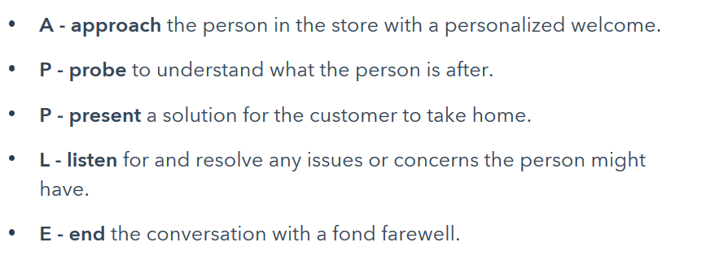
Customer success, service and support
Employees at an Apple Stores do not have sales targets, instead the focus is on building a genuine relationship with the customer to reduce attrition.
Apple developed a system of training that's based on an understanding of psychology and people skills.
https://blog.hubspot.com/service/apples-customer-service

Slide 14
Thank You !!!!!

